Slide 2
Quick probability review
There is a sample space of possible events
An event has a probability of happening (instead of a certainty).
Probability theory develops ways of estimating probabilities of events

Slide 3
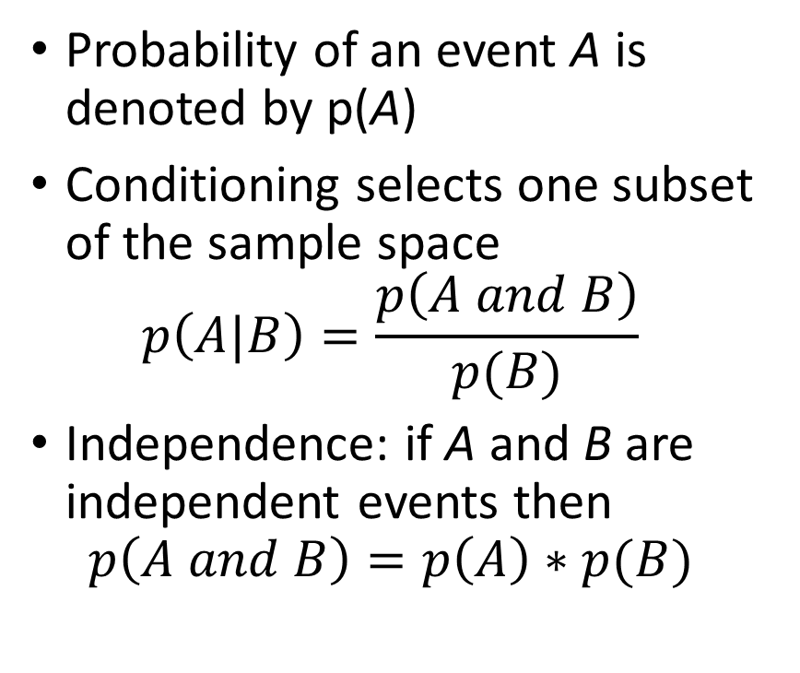
Quick probability review (2)
Probability of an event A is denoted by p(A)
Conditioning selects one subset of the sample space $p\left(A|B\right)=\frac{p\left(A and B\right)}{p(B)}$
Independence: if A and B are independent events then $p\left(A and B\right)=p\left(A\right)∗p(B)$

Slide 4
Probability Example?
You go to a friend’s house and you know that she has two children
Suddenly, a girl runs between the two of you, and your friends says “she is my daughter”
What is the probability that the other child is also a girl?

Slide 5
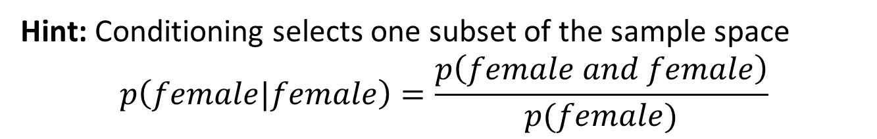
How bad are we at probabilities?
You go to a friend’s house and you know that she has two children
Suddenly, a girl runs between the two of you, and your friends says “she is my daughter”
What is the probability that the other child is also a girl?
Hint: Conditioning selects one subset of the sample space $$p\left(female|female\right)=\frac{p\left(female and female\right)}{p(female)}$$

Slide 6
How bad are we at probabilities?
Assume probability of a female equals the probability of a male = 0.5
Sample Space: ?
Probability of a Female =?
Probability of a Female and Female = ?

Slide 7
How bad are we at probabilities?
Assume probability of a female equals the probability of a male = 0.5
Sample Space: {F,F}, {F,M}, {M,F}, {M,M}
Probability of a Female = ?
Probability of a Female and Female = ?

Slide 8
How bad are we at probabilities?
Assume probability of a female equals the probability of a male = 0.5
Sample Space: {F,F}, {F,M}, {M,F}, {M,M}
Probability of a Female = ¾
Probability of a Female and Female = ?

Slide 9
How bad are we at probabilities?
Assume probability of a female equals the probability of a male = 0.5
Sample Space: {F,F}, {F,M}, {M,F}, {M,M}
Probability of a Female = ¾
Probability of a Female and Female = ¼

Slide 10
Contingency Table
 | Female | Male | Marginal Probability
Female | 0.25 | 0.25 | 0.5
Male | 0.25 | 0.25 | 0.5
Marginal Probability | 0.5 | 0.5 | 1

Slide 11
Contingency Table: Probability of Female
 | Female | Male | Marginal Probability
Female | 0.25 | 0.25 | 0.5
Male | 0.25 | 0.25 | 0.5
Marginal Probability | 0.5 | 0.5 | 1
P(Female) = 0.75

Slide 12
Contingency Table: Probability Female and Female
 | Female | Male | Marginal Probability
Female | 0.25 | 0.25 | 0.5
Male | 0.25 | 0.25 | 0.5
Marginal Probability | 0.5 | 0.5 | 1
P(Female and Female) = 0.25

Slide 13
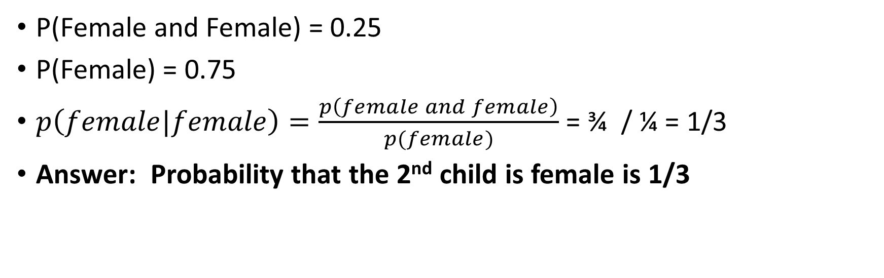
How bad are we at probabilities?
P(Female and Female) = 0.25
P(Female) = 0.75
$p\left(female|female\right)=\frac{p\left(female and female\right)}{p(female)}$ = ¾ / ¼ = 1/3
Answer: Probability that the 2nd child is female is 1/3

